Slide 1
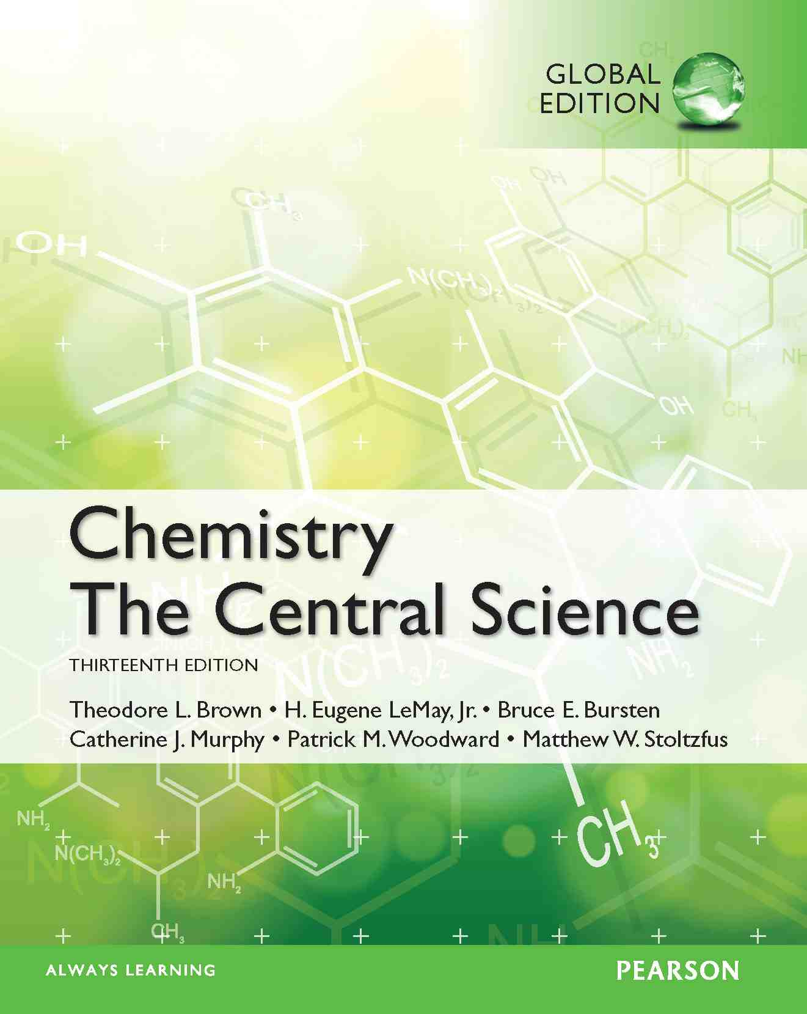
Lecture Presentation
Chapter 14 Chemical Kinetics
James F. Kirby
Quinnipiac University
Hamden, CT

Slide 2
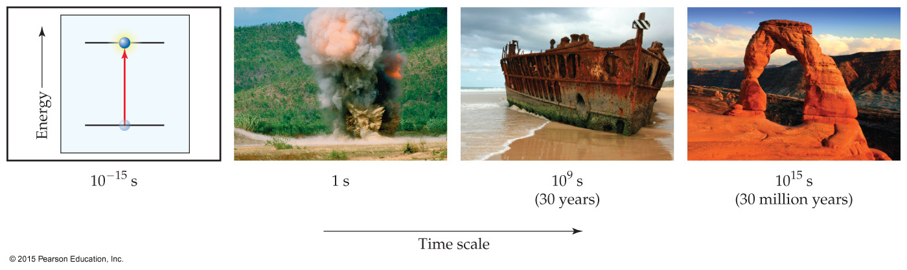
Chemical Kinetics
In chemical kinetics we study the rate (or speed) at which a chemical process occurs.
Besides information about the speed at which reactions occur, kinetics also sheds light on the reaction mechanism, a molecular-level view of the path from reactants to products.

Slide 3
Factors that Affect Reaction Rates
Physical state of the reactants
Reactant concentrations
Reaction temperature
Presence of a catalyst

Slide 4
Physical State of the Reactants
The more readily the reactants collide, the more rapidly they react.
Homogeneous reactions are often faster.
Heterogeneous reactions that involve solids are faster if the surface area is increased; i.e., a fine powder reacts faster than a pellet or tablet.

Slide 5
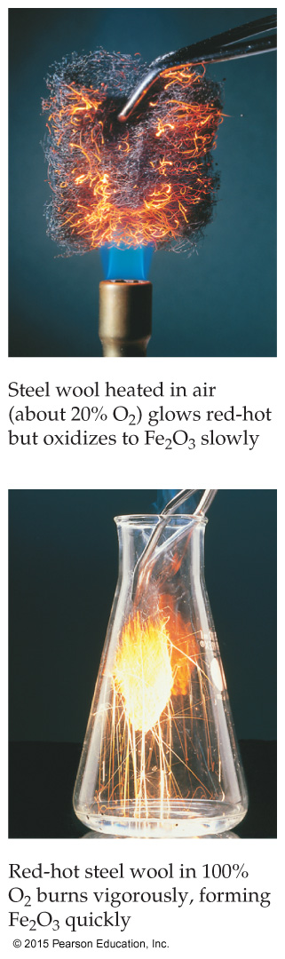
Reactant Concentrations
Increasing reactant concentration generally increases reaction rate.
Since there are more molecules, more collisions occur.

Slide 6
Temperature
Reaction rate generally increases with increased temperature.
Kinetic energy of molecules is related to temperature.
At higher temperatures, molecules move more quickly, increasing numbers of collisions and the energy the molecules possess during the collisions.

Slide 7
Presence of a Catalyst
Catalysts affect rate without being in the overall balanced equation.
Catalysts affect the kinds of collisions, changing the mechanism (individual reactions that are part of the pathway from reactants to products).
Catalysts are critical in many biological reactions.

Slide 8
Reaction Rate
Rate is a change in concentration over a time period: Δ[ ]/Δt.
Δ means “change in.”
[ ] means molar concentration.
t represents time.
Types of rate measured:
average rate
instantaneous rate
initial rate

Slide 9
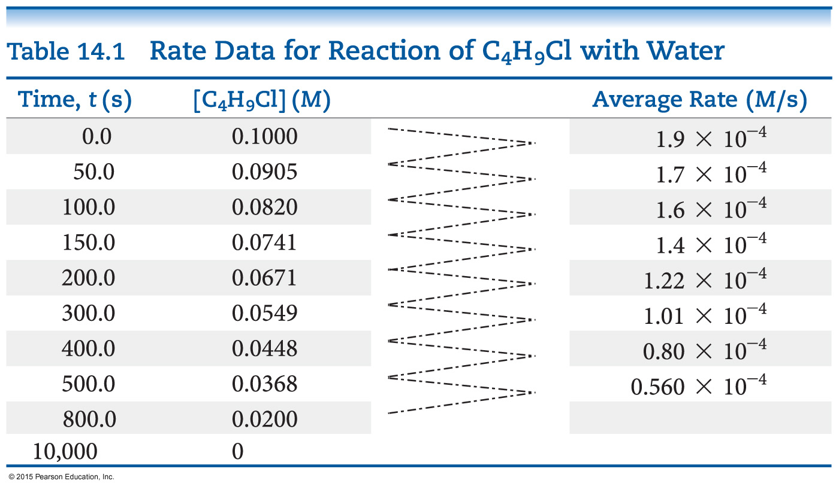
Following Reaction Rates
Rate of a reaction is measured using the concentration of a reactant or a product over time.
In this example, [C₄H₉Cl] is followed.

Slide 10
Following Reaction Rates
The average rate is calculated by the –(change in [C₄H₉Cl]) ÷ (change in time).
The table shows the average rate for a variety of time intervals.

Slide 11
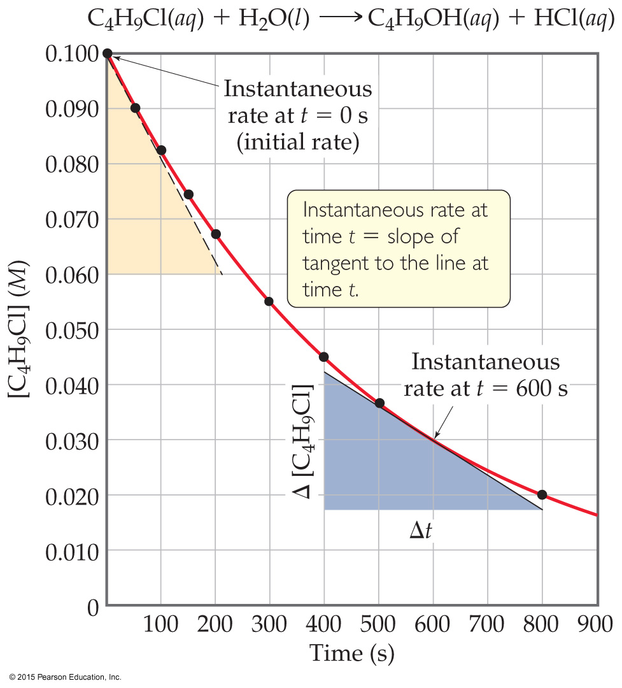
Plotting Rate Data
A plot of the data gives more information about rate.
The slope of the curve at one point in time gives the instantaneous rate.
The instantaneous rate at time zero is called the initial rate; this is often the rate of interest to chemists.
This figure shows instantaneous and initial rate of the earlier example.
Note: Reactions typically slow down over time!

Slide 12

Relative Rates
As was said, rates are followed using a reactant or a product. Does this give the same rate for each reactant and product?
Rate is dependent on stoichiometry.
If we followed use of C₄H₉Cl and compared it to production of C₄H₉OH, the values would be the same. Note that the change would have opposite signs—one goes down in value, the other goes up.

Slide 13

Relative Rates and Stoichiometry
What if the equation is not 1:1?
What will the relative rates be for:
2 O₃ (g) → 3 O₂ (g)

Slide 14
Determining Concentration Effect on Rate
How do we determine what effect the concentration of each reactant has on the rate of the reaction?
We keep every concentration constant except for one reactant and see what happens to the rate. Then, we change a different reactant. We do this until we have seen how each reactant has affected the rate.

Slide 15
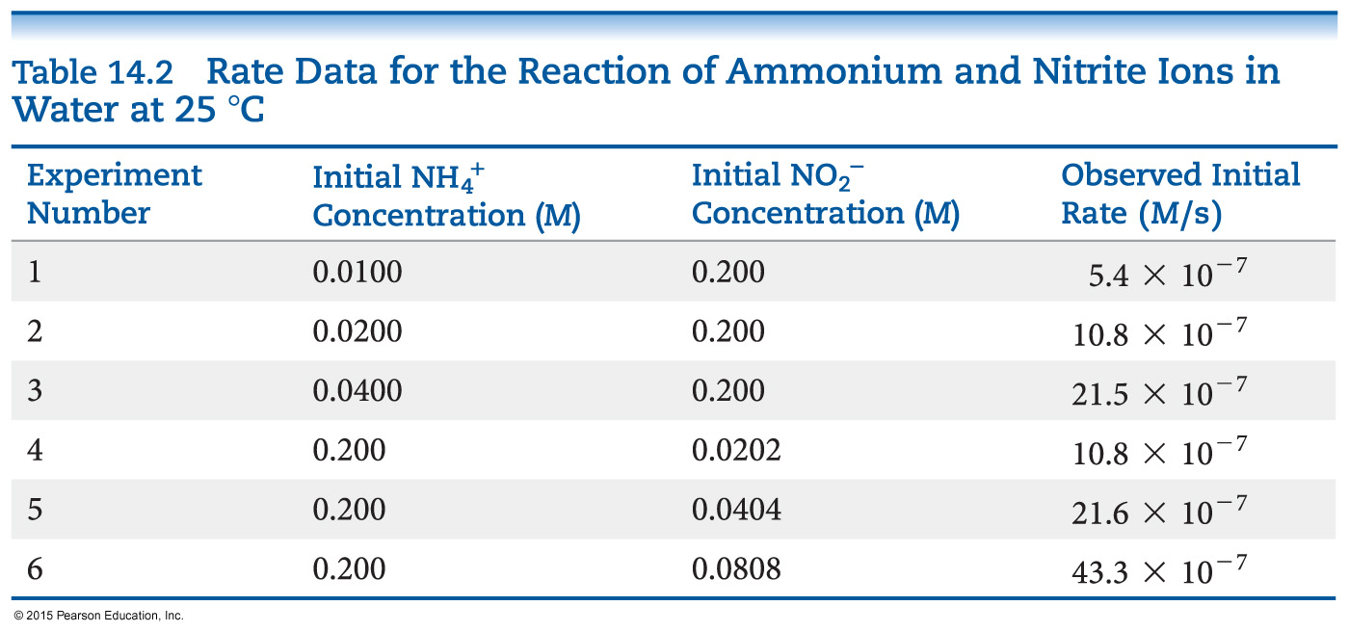
An Example of How Concentration Affects Rate
Experiments 1–3 show how [NH₄⁺] affects rate.
Experiments 4–6 show how [NO₂⁻] affects rate.
Result: The rate law, which shows the relationship between rate and concentration for all reactants:
Rate = k [NH₄⁺] [NO₂⁻] (rate law)

Slide 16
More about Rate Law
The exponents tell the order of the reaction with respect to each reactant.
In our example from the last slide:
Rate = k [NH₄⁺] [NO₂⁻]
The order with respect to each reactant is 1. (It is first order in NH₄⁺ and NO₂⁻.)
The reaction is second order (1 + 1 = 2; we just add up all of the reactants’ orders to get the reaction’s order).
What is k? It is the rate constant. It is a temperature-dependent quantity.

Slide 17
First Order Reactions
Some rates depend only on one reactant to the first power.
These are first order reactions.
The rate law becomes:
Rate = k [A]

Slide 18
Relating k to [A] in a First Order Reaction
rate = k [A] (rate law)
rate = −Δ [A] / Δt (rate expression)
So: k [A] = −Δ [A] / Δt
Rearrange to: Δ [A] / [A] = − k Δt
Integrate: ln ([A] / [A]_{o}) = − k t
Rearrange: ln [A] = − k t + ln [A]_{o}
Note: this follows the equation of a line:
y = m x + b
So, a plot of ln [A] vs. t is linear.

Slide 19
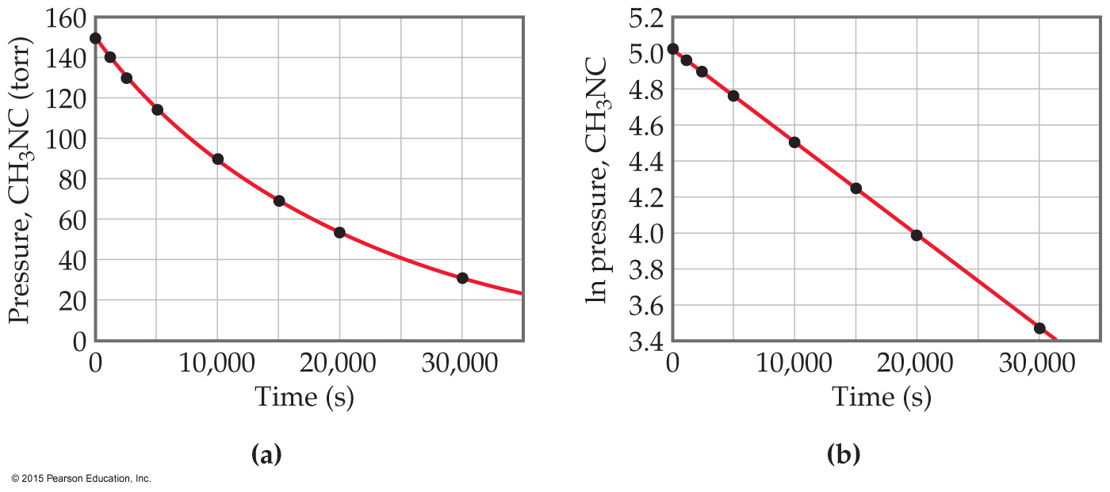
Ex: Conversion of Methyl Isonitrile to Acetonitrile
The equation for the reaction:
CH₃NC → CH₃CN
It is first order.
Rate = k [CH₃NC]

Slide 20
Finding the Rate Constant, k
Besides using the rate law, we can find the rate constant from the plot of ln [A] vs. t.
Remember the integrated rate law:
ln [A] = − k t + ln [A]_{o}
The plot will give a line. Its slope will equal −k.

Slide 21
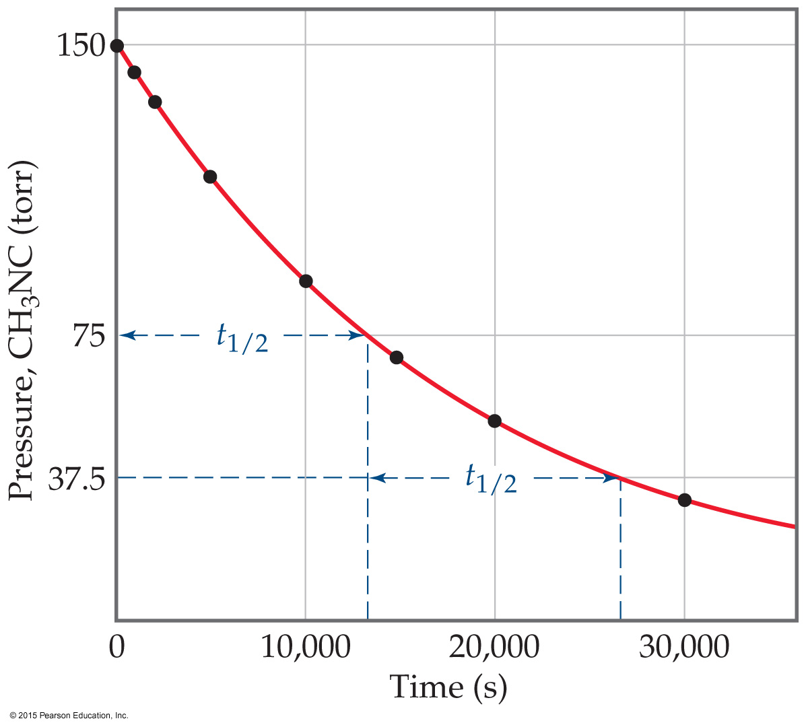
Half-life (t_{½})
Definition: The amount of time it takes for one-half of a reactant to be used up in a chemical reaction.
First Order Reaction:
ln [A] = − k t + ln [A]_{o}
ln ([A]_{o}/2) = − k t_{½} + ln [A]_{o}
− ln ([A]_{o}/2) + ln [A]_{o} = k t_{½}
ln ([A]_{o} / [A]_{o}/2) = k t_{½}
ln 2 = k t_{½} or t_{½} = 0.693/k

Slide 22
Second Order Reactions
Some rates depend only on a reactant to the second power.
These are second order reactions.
The rate law becomes:
Rate = k [A]²

Slide 23
Solving the Second Order Reaction for A → Products
rate = k [A]²
rate = − Δ [A] / Δ t
So, k [A]² = − Δ [A] / Δ t
Rearranging: Δ [A] / [A]² = − k Δ t
Using calculus: 1/[A] = 1/[A]_{o} + k t
Notice: The linear relationships for first order and second order reactions differ!

Slide 24
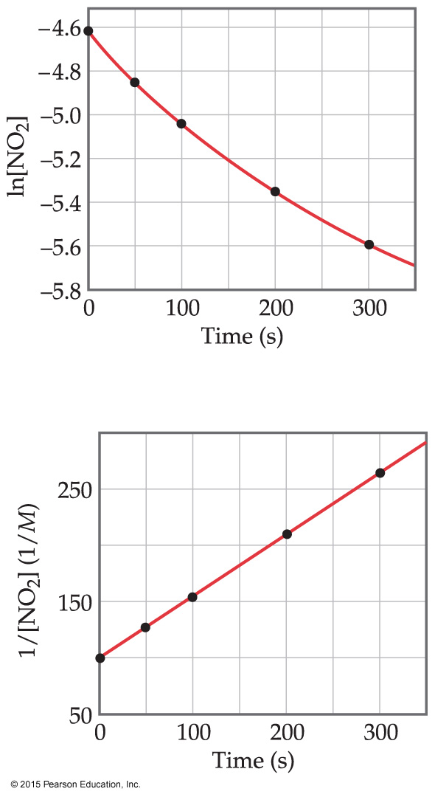
An Example of a Second Order Reaction: Decomposition of NO₂
1/[A] = 1/[A]_{o} + k t
A plot following NO₂ decomposition shows that it must be second order because it is linear for 1/[NO₂], not linear for ln [NO₂].
Equation:
NO₂ → NO + ½ O₂

Slide 25
Half-Life and Second Order Reactions
Using the integrated rate law, we can see how half-life is derived:
1/[A] = 1/[A]_{o} + k t
1/([A]_{o}/2) = 1/[A]_{o} + k t_{½}
2/[A]_{o} −1/[A]_{o} = k t_{½}
t_{½} = 1 / (k [A]_{o})
So, half-life is a concentration-dependent quantity for second order reactions!

Slide 26
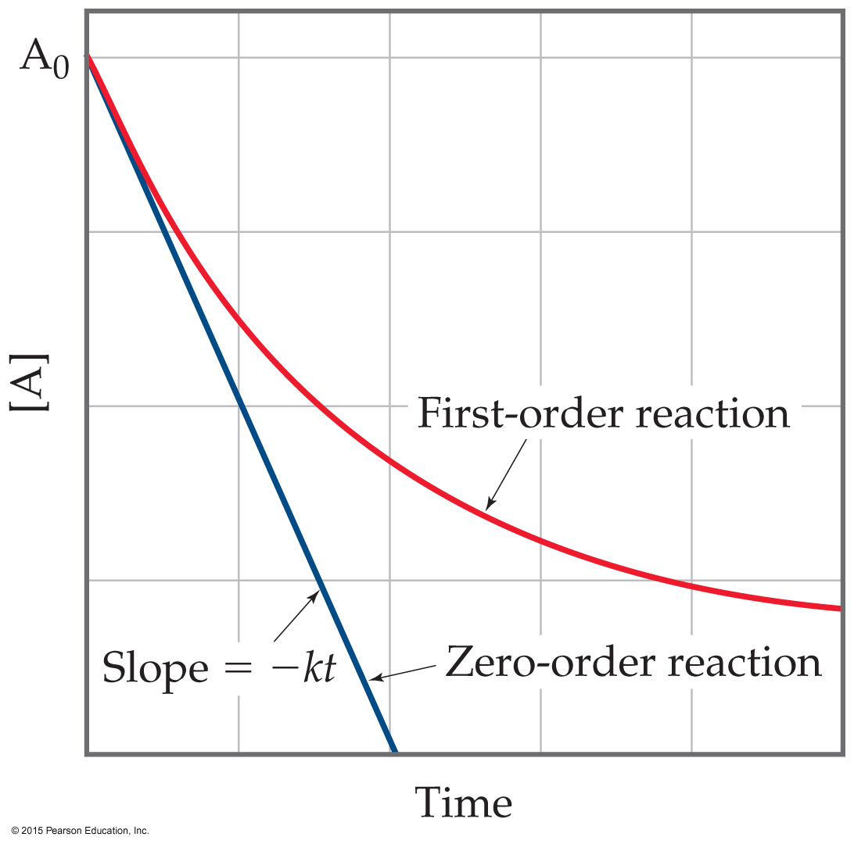
Zero Order Reactions
Occasionally, rate is independent of the concentration of the reactant:
Rate = k
These are zero order reactions.
These reactions are linear in concentration.

Slide 27
Factors That Affect Reaction Rate
Temperature
Frequency of collisions
Orientation of molecules
Energy needed for the reaction to take place (activation energy)

Slide 28
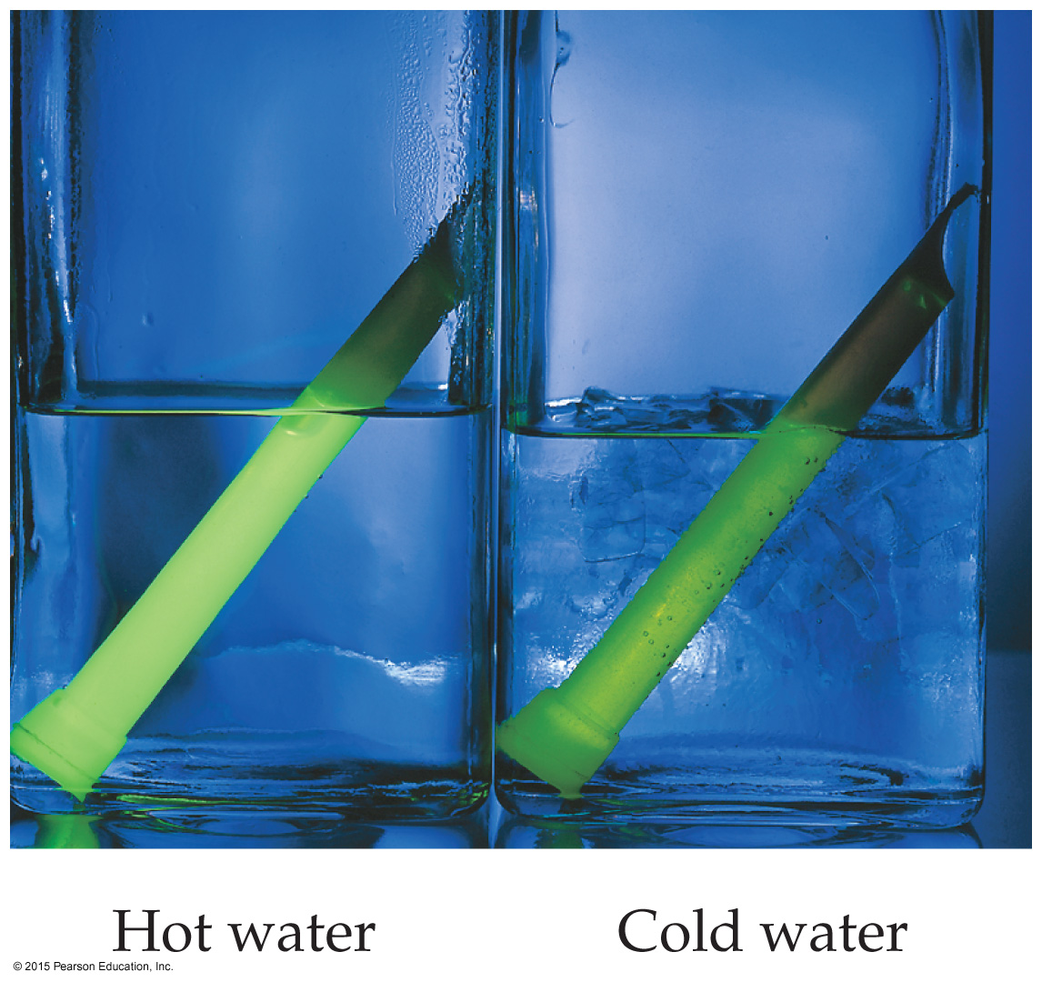
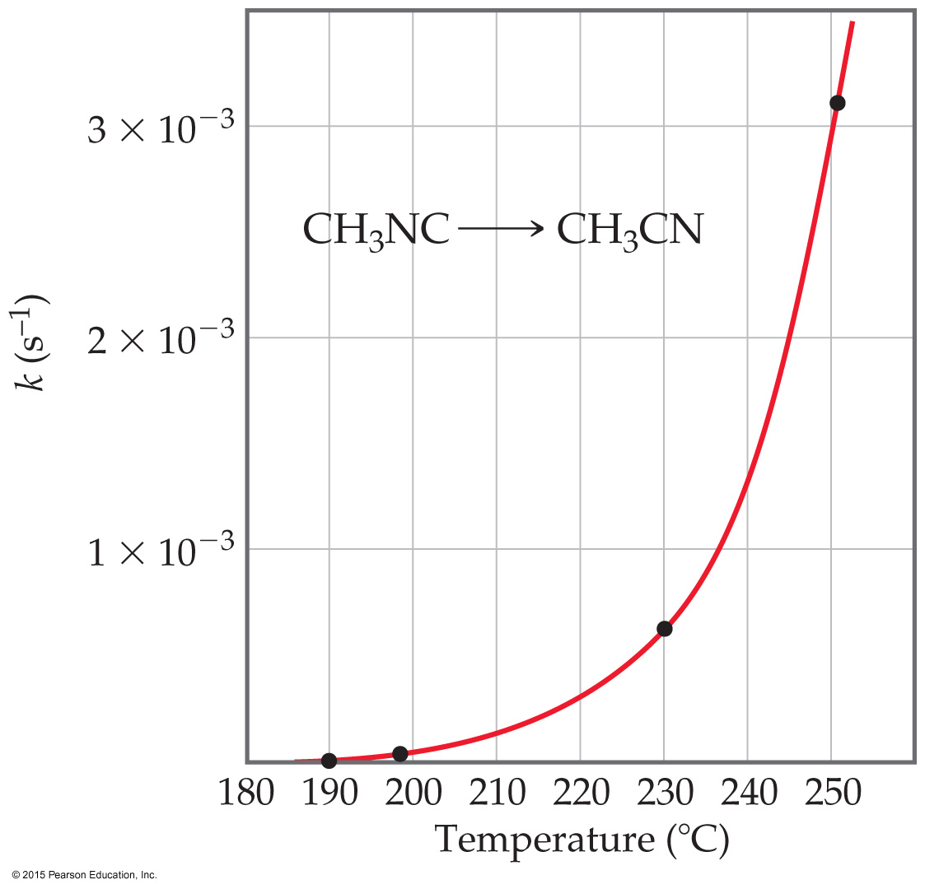
Temperature and Rate
Generally, as temperature increases, rate increases.
The rate constant is temperature dependent: it increases as temperature increases.
Rate constant doubles (approximately) with every 10 ºC rise.

Slide 29
The Collision Model
In a chemical reaction, bonds are broken and new bonds are formed.
Molecules can only react if they collide with each other.

Slide 30
Frequency of Collisions
The collision model is based on the kinetic molecular theory.
Molecules must collide to react.
If there are more collisions, more reactions can occur.
So, if there are more molecules, the reaction is faster.
Also, if the temperature is higher, molecules move faster, causing more collisions and a higher rate of reaction.

Slide 31
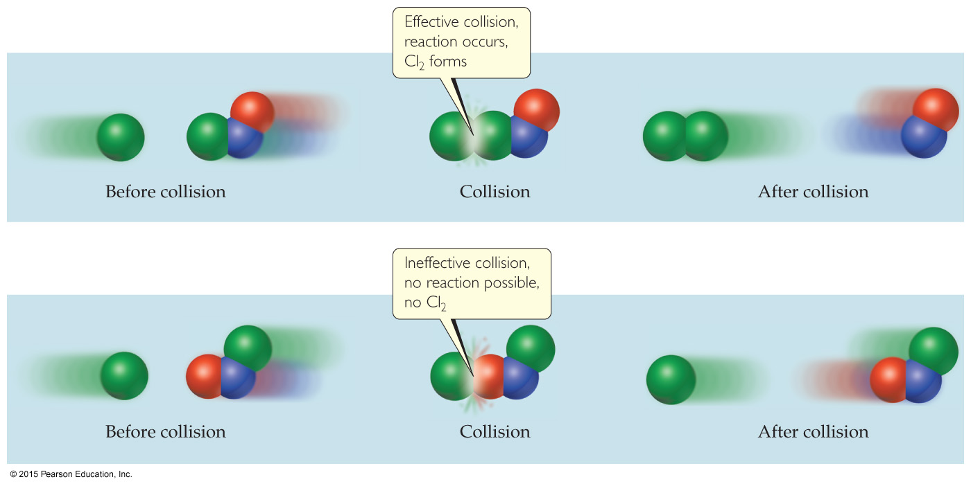
Orientation of Molecules
Molecules can often collide without forming products.
Aligning molecules properly can lead to chemical reactions.
Bonds must be broken and made and atoms need to be in proper positions.

Slide 32
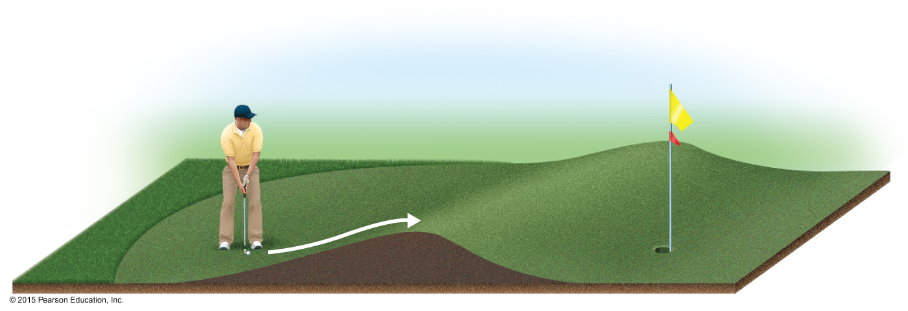
Energy Needed for a Reaction to Take Place (Activation Energy)
The minimum energy needed for a reaction to take place is called activation energy.
An energy barrier must be overcome for a reaction to take place, much like the ball must be hit to overcome the barrier in the figure below.

Slide 33
Transition State (Activated Complex)
Reactants gain energy as the reaction proceeds until the particles reach the maximum energy state.
The organization of the atoms at this highest energy state is called the transition state (or activated complex).
The energy needed to form this state is called the activation energy.

Slide 34
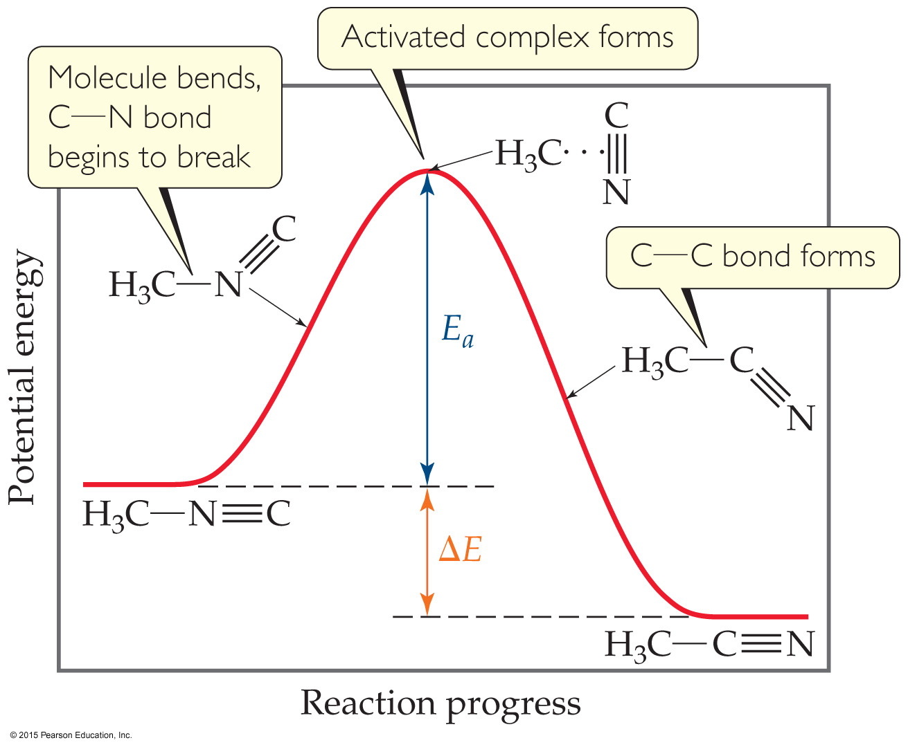
Reaction Progress
Plots are made to show the energy possessed by the particles as the reaction proceeds.
At the highest energy state, the transition state is formed.
Reactions can be endothermic or exothermic after this.

Slide 35
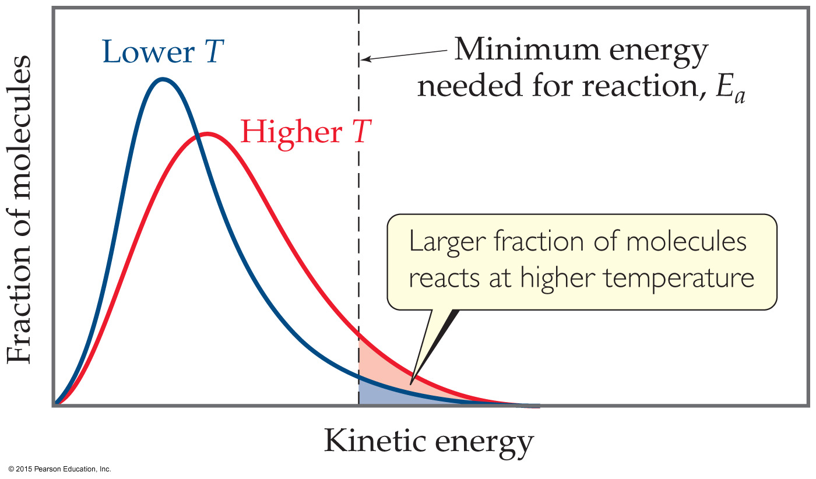
Distribution of the Energy of Molecules
Gases have an average temperature, but each individual molecule has its own energy.
At higher energies, more molecules possess the energy needed for the reaction to occur.

Slide 36
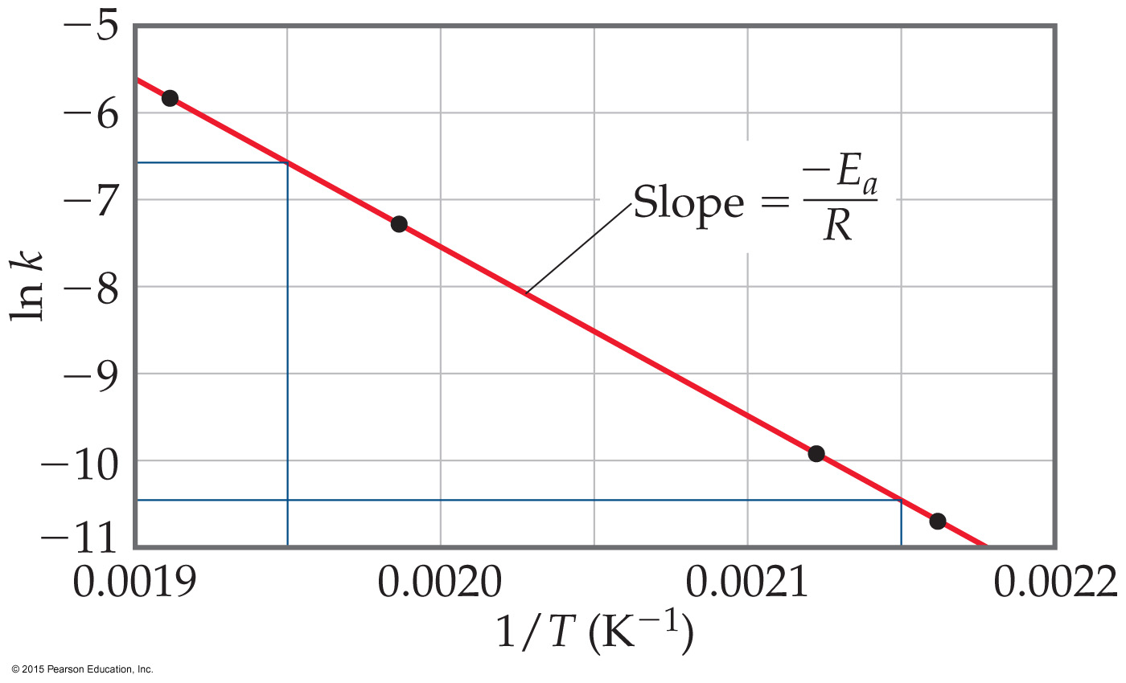
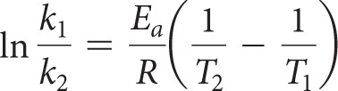
The Relationship Between Activation Energy & Temperature
Arrhenius noted relationship between activation energy and temperature: k = Ae^{−Ea/RT}
Activation energy can be determined graphically by reorganizing the equation: ln k = −E_{a}/RT + ln A

Slide 37
Law vs. Theory
Kinetics gives what happens. We call the description the rate law.
Why (how) do we observe that rate law? We explain with a theory called a mechanism.
A mechanism is a series of stepwise reactions that show how reactants become products.

Slide 38
Reaction Mechanisms
Reactions may occur all at once or through several discrete steps.
Each of these processes is known as an elementary reaction or elementary process.

Slide 39
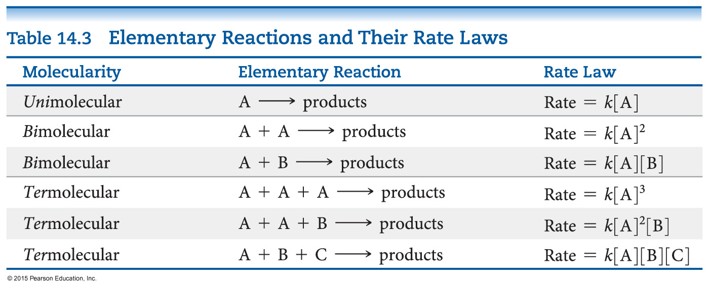
Molecularity
The molecularity of an elementary reaction tells how many molecules are involved in that step of the mechanism.

Slide 40
Termolecular?
Termolecular steps require three molecules to simultaneously collide with the proper orientation and the proper energy.
These are rare, if they indeed do occur.
These must be slower than unimolecular or bimolecular steps.
Nearly all mechanisms use only unimolecular or bimolecular reactions.

Slide 41
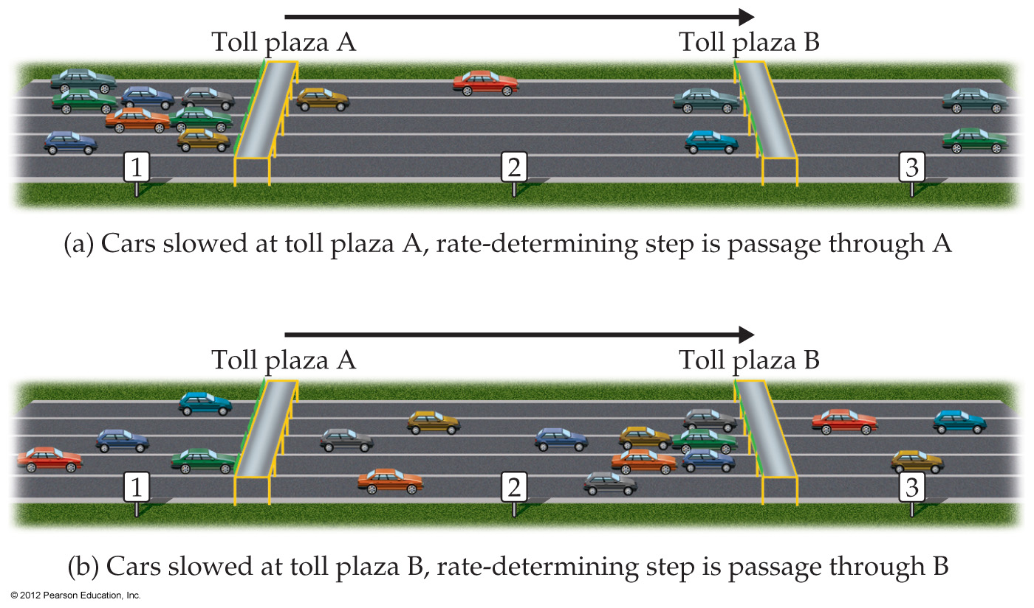
What Limits the Rate?
The overall reaction cannot occur faster than the slowest reaction in the mechanism.
We call that the rate-determining/limiting step.

Slide 42
What is Required of a Plausible Mechanism?
The rate law must be able to be derived from the rate-determining step.
The stoichiometry must be obtained when all steps are added up.
Each step must balance, like any equation.
All intermediates are made and used up.
Any catalyst is used and regenerated.

Slide 43
A Mechanism With a Slow Initial Step
Overall equation: NO₂ + CO → NO + CO₂
Rate law: Rate = k [NO₂]²
If the first step is the rate-determining step, the coefficients on the reactants side are the same as the order in the rate law!
So, the first step of the mechanism begins:
NO₂ + NO₂ →

Slide 44
A Mechanism With a Slow Initial Step (continued)
The easiest way to complete the first step is to make a product:
NO₂ + NO₂ → NO + NO₃
We do not see NO₃ in the stoichiometry, so it is an intermediate, which needs to be used in a faster next step.
NO₃ + CO → NO₂ + CO₂

Slide 45
A Mechanism With a Slow Initial Step (completed)
Since the first step is the slowest step, it gives the rate law.
If you add up all of the individual steps (2 of them), you get the stoichiometry.
Each step balances.
This is a plausible mechanism.

Slide 46
A Mechanism With a Fast Initial Step
Equation for the reaction:
2 NO + Br₂ ⇌ 2 NOBr
The rate law for this reaction is found to be
Rate = k [NO]² [Br₂]
Because termolecular processes are rare, this rate law suggests a multistep mechanism.

Slide 47
A Mechanism With a Fast Initial Step (continued)
The rate law indicates that a quickly established equilibrium is followed by a slow step.
Step 1: NO + Br₂ ⇌ NOBr₂
Step 2: (rds) NOBr₂ + NO → 2 NOBr

Slide 48
What is the Rate Law?
The rate of the overall reaction depends upon the rate of the slow step.
The rate law for that step would be
Rate = k₂[NOBr₂] [NO]
But how can we find [NOBr₂]?

Slide 49
[NOBr₂] (An Intermediate)?
NOBr₂ can react two ways:
With NO to form NOBr.
By decomposition to reform NO and Br₂.
The reactants and products of the first step are in equilibrium with each other.
For an equilibrium (discussed in the next chapter):
Rate_{f} = Rate_{r}

Slide 50
The Rate Law (Finally!)
Substituting for the forward and reverse rates:
k₁ [NO] [Br₂] = k₋₁ [NOBr₂]
Solve for [NOBr₂], then substitute into the rate law:
Rate = k₂ (k₁/k₋₁) [NO] [Br₂] [NO]
This gives the observed rate law!
Rate = k [NO]² [Br₂]

Slide 51
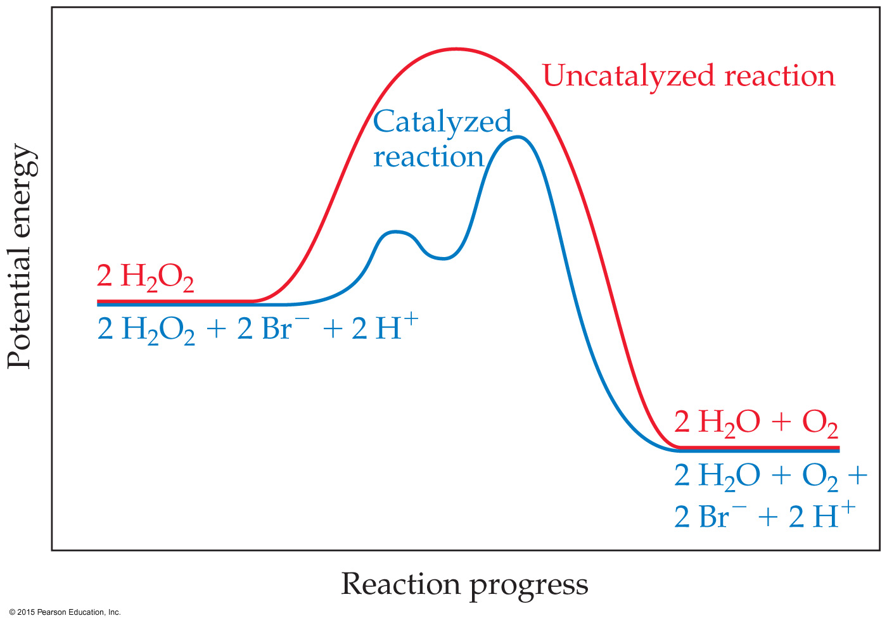
Catalysts
Catalysts increase the rate of a reaction by decreasing the activation energy of the reaction.
Catalysts change the mechanism by which the process occurs.

Slide 52
Types of Catalysts
Homogeneous catalysts
Heterogeneous catalysts
Enzymes (catalysts in biological system)

Slide 53
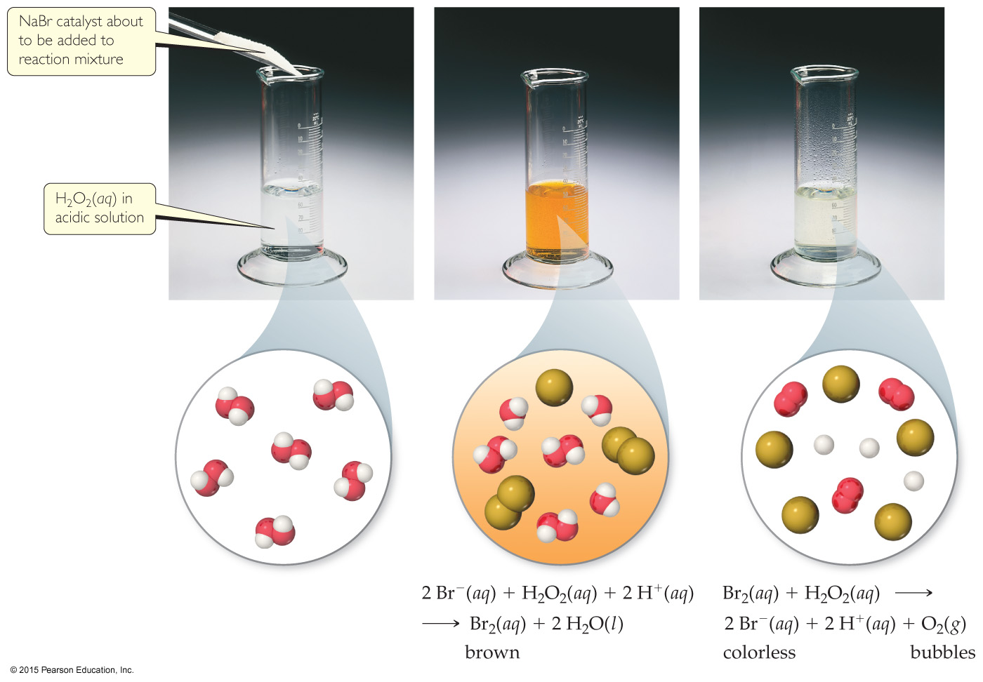
Homogeneous Catalysts
The reactants and catalyst are in the same phase.
Many times, reactants and catalyst are dissolved in the same solvent, as seen below.

Slide 54
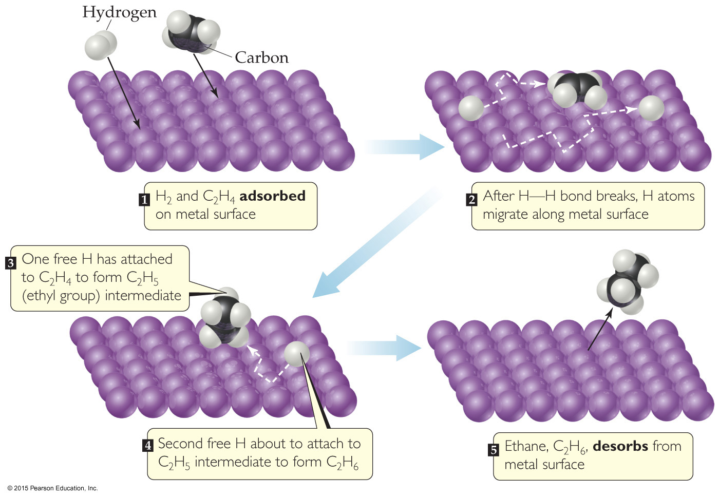
Heterogeneous Catalysts
The catalyst is in a different phase than the reactants.
Often, gases are passed over a solid catalyst.
The adsorption of the reactants is often the rate-determining step.

Slide 55
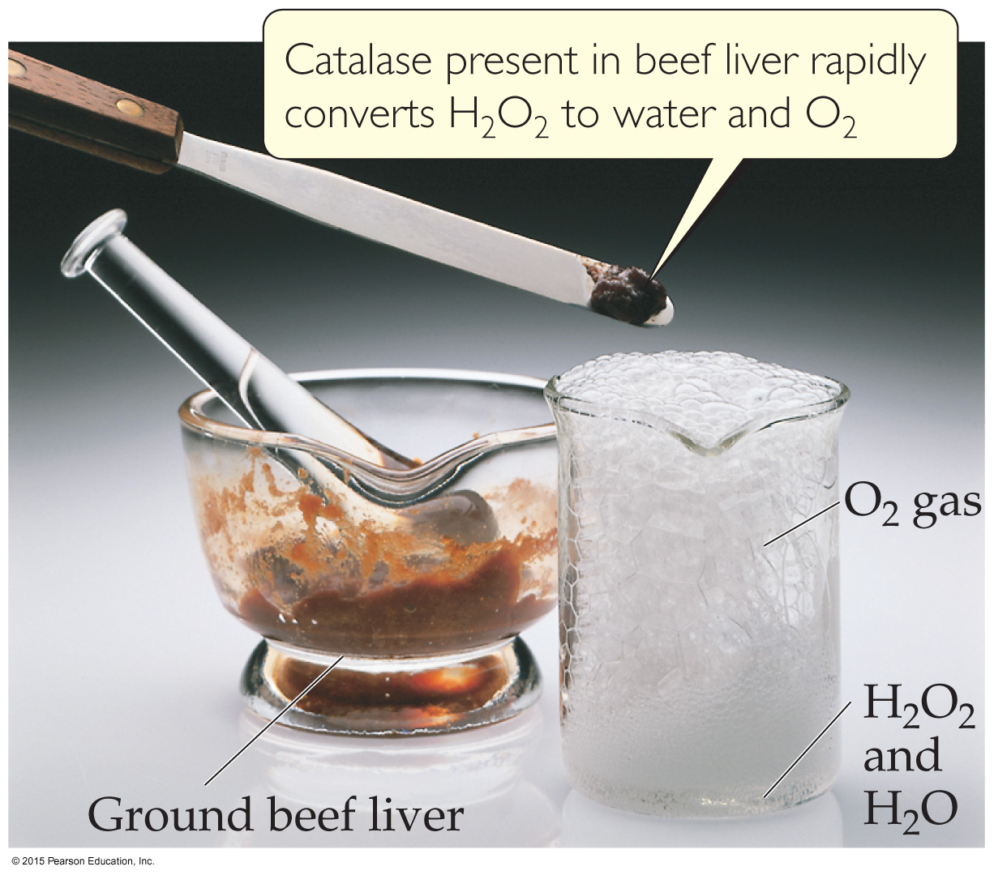
Enzymes
Enzymes are biological catalysts.
They have a region where the reactants attach. That region is called the active site. The reactants are referred to as substrates.

Slide 56
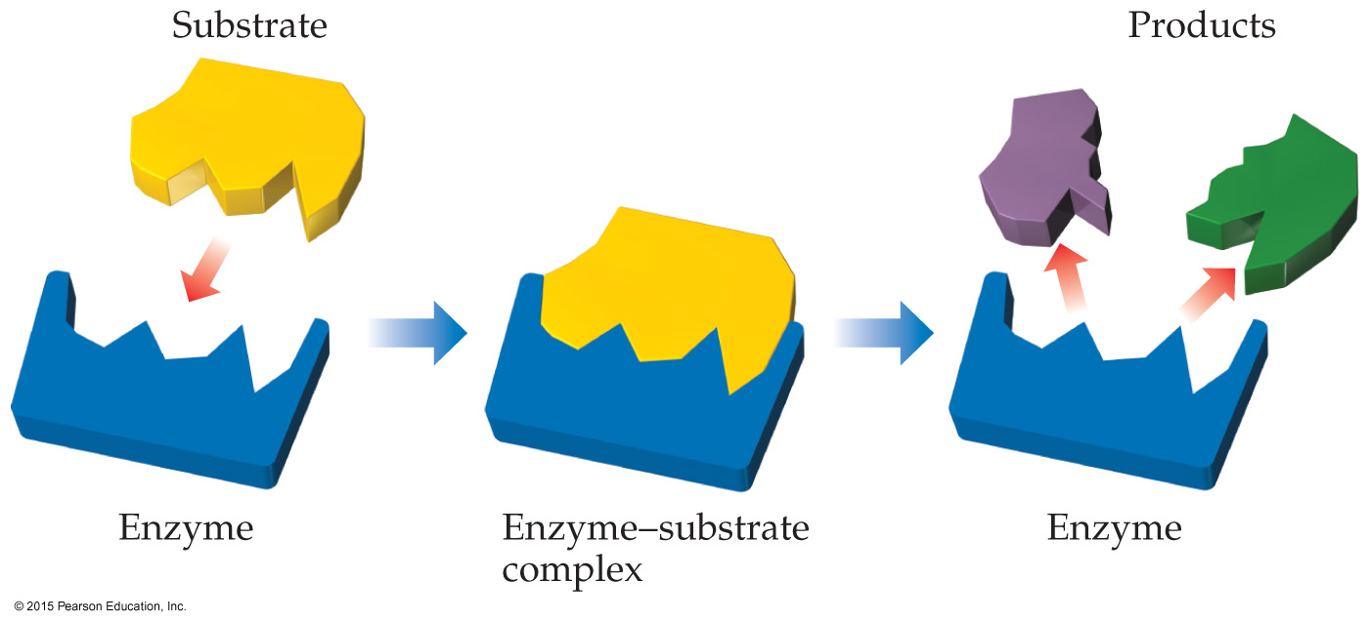
Lock-and-Key Model
In the enzyme–substrate model, the substrate fits into the active site of an enzyme, much like a key fits into a lock.
They are specific.

